Slide 1
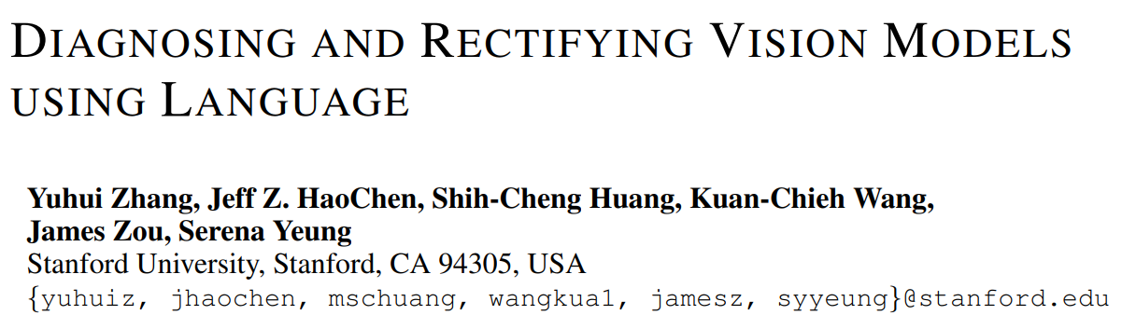
Diagnosing and rectifying vision models using language-ICLR2023

Slide 2
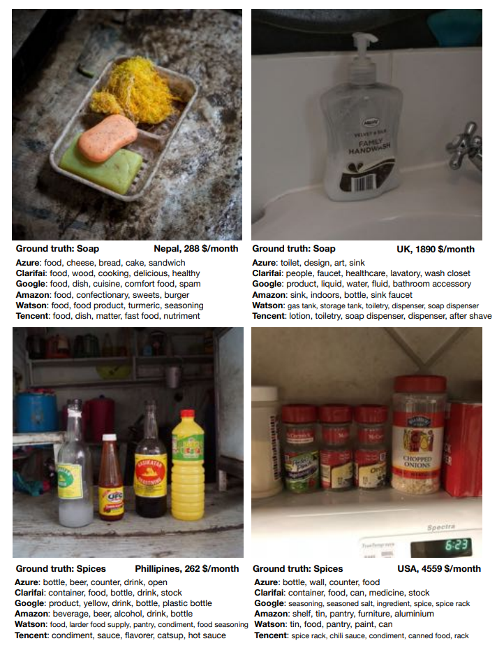
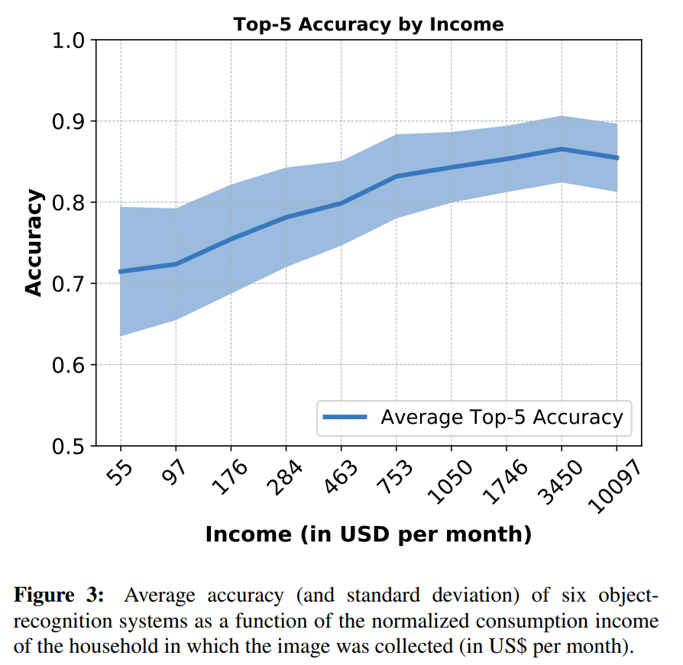
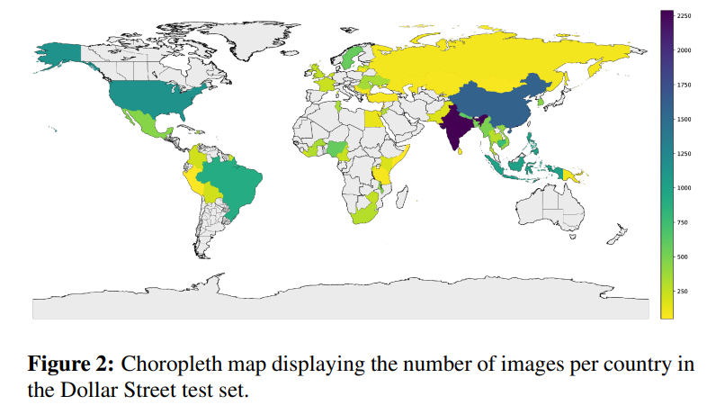
Diagnosing and rectifying vision models using language-ICLR2023
Model Diagnosis:
Aims to gain a systematic and comprehensive understanding of when and why models fail.
Does Object Recognition Work for Everyone?-CVPR2020

Slide 3
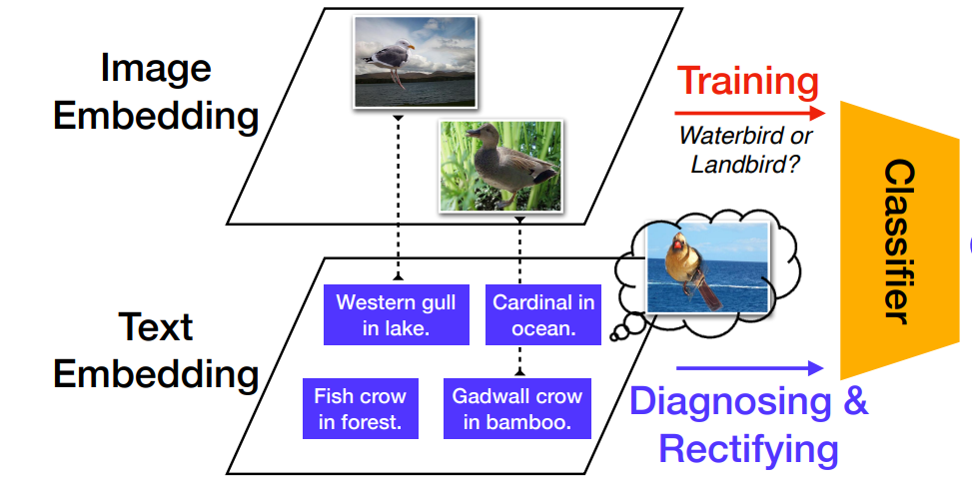
Diagnosing and rectifying vision models using language-ICLR2023
Motivation:
The traditional process of diagnosing model behaviors in deployment settings involves labor-intensive data acquisition and annotation.
It is often easier to generate a set of diverse natural language inputs by combining known attributes and prompt generators than to collect a set of image inputs representing the same desired concepts.

Slide 4
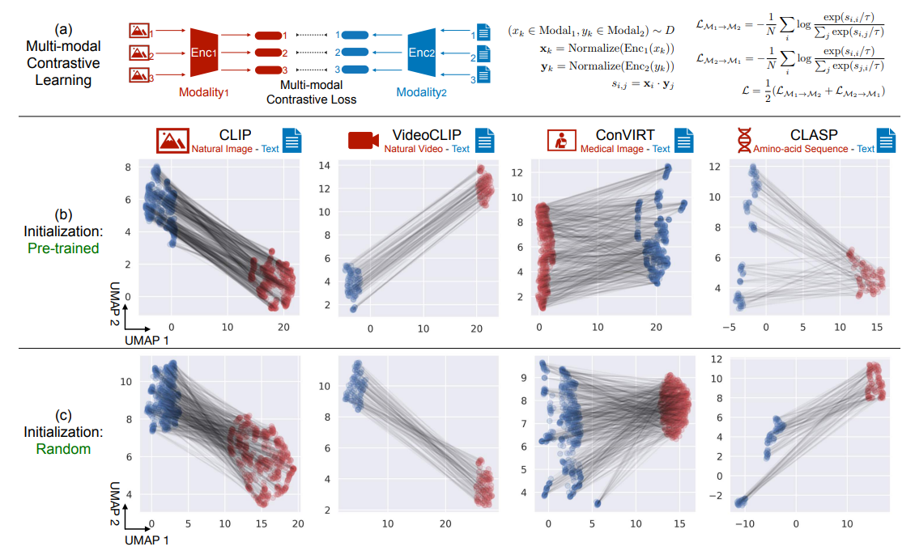
Diagnosing and rectifying vision models using language-ICLR2023
Analysis
Are text inputs good proxies for images in contrastive representation space?
Mind the Gap: Understanding the Modality Gap in Multi-modal Contrastive Representation Learning-NIPS2022

Slide 5
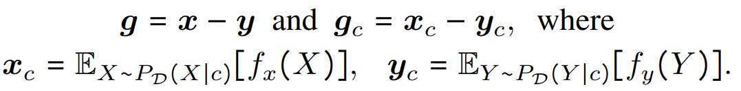
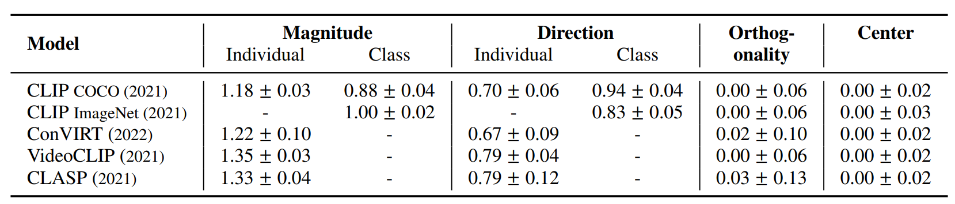

Diagnosing and rectifying vision models using language-ICLR2023
Modality Gap Geometry
Are text inputs good proxies for images in contrastive representation space?
The modality gap between corresponding image and text embeddings can be approximated by a constant vector, particularly at the class level.
The modality gap is orthogonal to the span of image embeddings and text embeddings, and image embeddings and text embeddings have zero mean in the subspace orthogonal to the modality gap.

Slide 6
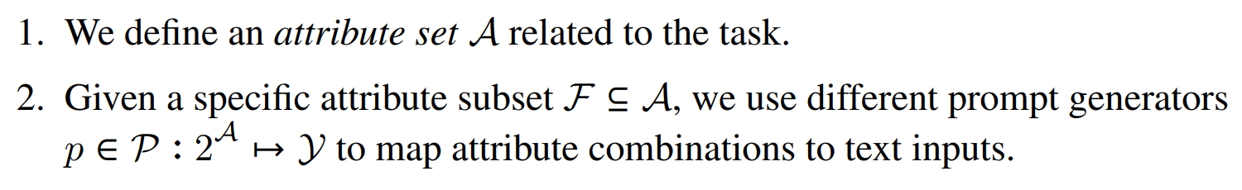
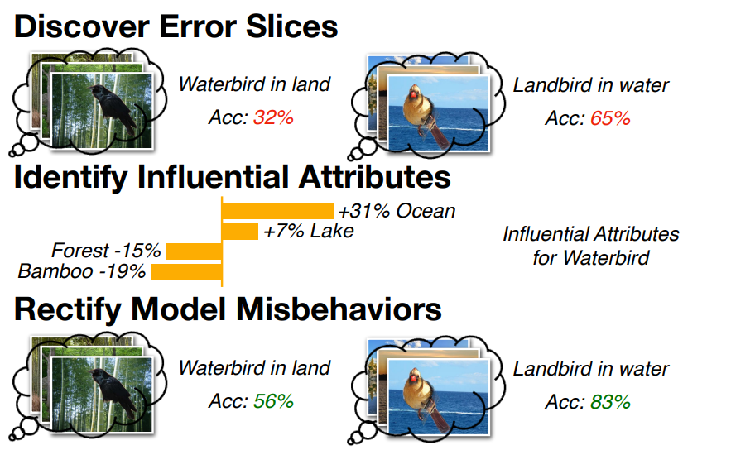

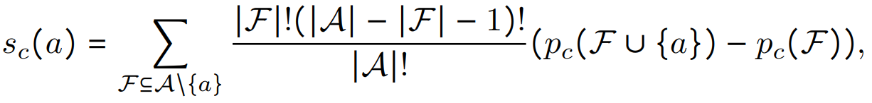
Diagnosing and rectifying vision models using language-ICLR2023
DrML: Diagnosing and Rectifying Vision Models using Language
Discovering Error Slices through Language
Identifying Influential Attributes through Language
Shapley value:

Slide 7
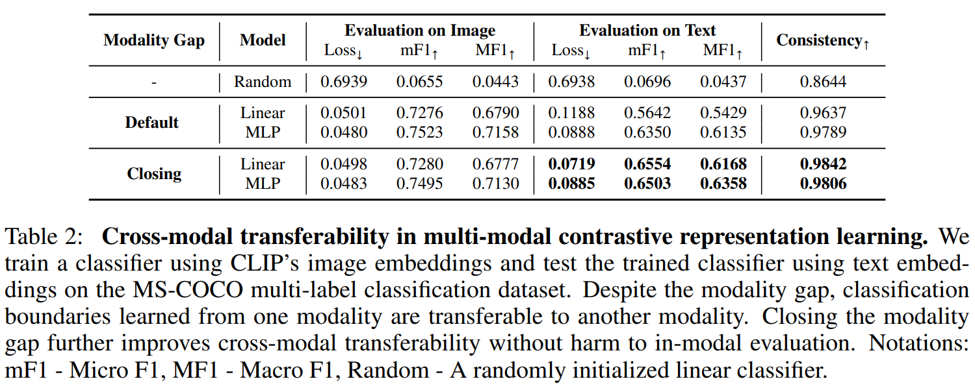
Diagnosing and rectifying vision models using language-ICLR2023
Experiments-Cross-modal Transferability
During training, instead of feeding x to the model h, we feed it with $x − Ex[x].$
During cross-modal evaluation, we feed $y − Ey[y]$instead of $y$

Slide 8
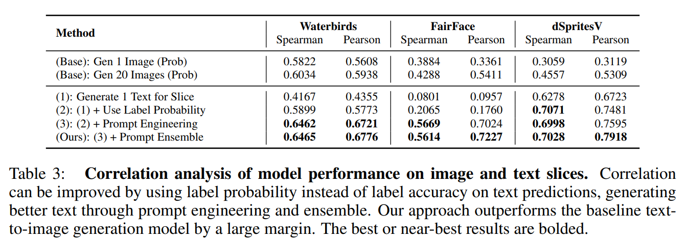
Diagnosing and rectifying vision models using language-ICLR2023
Experiments-Are Generated Language Prompts Good Predictors of Error Slices?

Slide 9
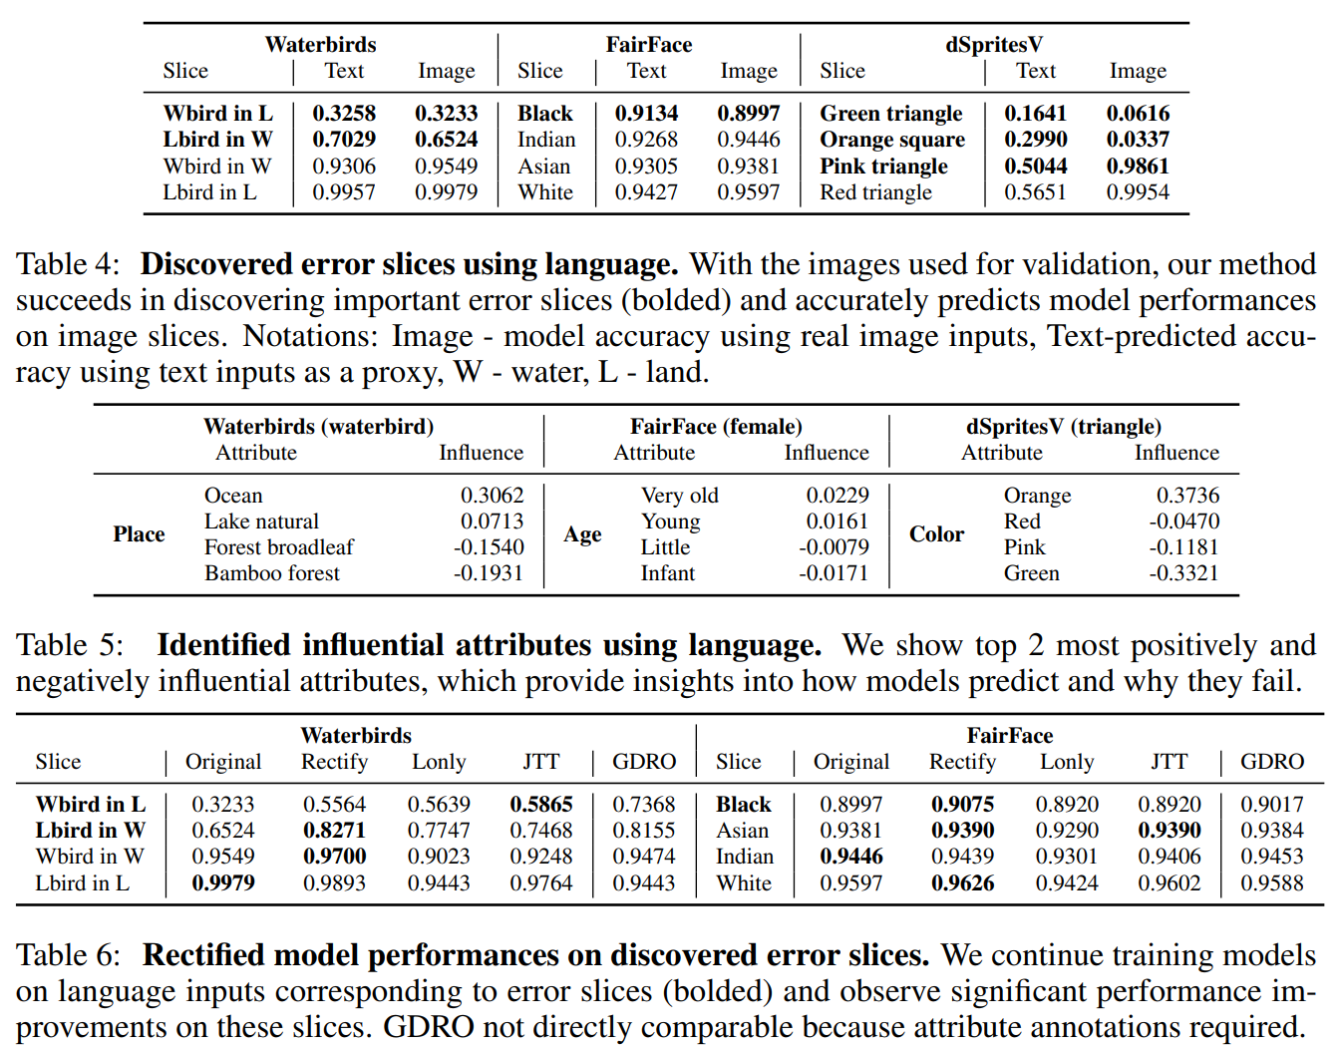
Diagnosing and rectifying vision models using language-ICLR2023
Experiments

Slide 10
Thanks

